Slide 1
LIBS 7001 Week 3: Arrangement
identify ways to arrange an overall discourse, including "organic" and "taxonomic"
recognize different types of beginnings, endings, transitions, and forms of a thesis
compare the effectiveness of short articles using different methods of arrangement
plan a short text arranged to suit the audience, purpose, and thesis.

Slide 2
The Importance of Arrangement
[E]very discourse, like a living creature, should be so put together that it has its own body and lacks neither head nor feet, middle nor extremities, all composed in such a way that they suit both each other and the whole.
- Socrates (4th century BCE, Athens)
information on slides 2-9 adapted from: T. Byrd, Georgia Institute of Technology URL: http://www.lcc.gatech.edu/gallery/rhetoric/terms/arrangement.html
and J.Sosnoski, U.Illinois, "Terms for Cultural Rhetorics”
URL: http://www.engl.uic.edu/~sosnoski/cr/TERMS/arrangement.htm

Slide 3
Arrangement in Classical Rhetoric
Arrangement is the second of the five traditional “canons” (principles) of rhetoric:
  invention: finding & developing a topic
  arrangement
  style
  memory [critical in spoken discourse]
  delivery.

Slide 4
What is Arrangement?
also called "disposition" or "order of ideas”
the art of ordering the material in a text in a way that most appropriately and smoothly delivers the intended information.
one of the most important canons of rhetoric: comes second after invention.

Slide 5
Arrangement, cont.
but: if parts are poorly arranged, the whole work may be unclear or lose its desired effect.
two aspects:
  overall text: big picture, from Introduction to Conclusion
  various parts within a text: the “middle” sections or paragraphs; beginning, ending, transitions

Slide 6
Tom Tomorrow Cartoon
What do you see first on this page? next?
How and where does this "text" begin and end?
What's the message of this text?What is the sequence of ideas that convey the meaning?
How is this visual / verbal message organized?
What's the interaction among visuals and print?
Are either the visuals or the printed words understandable apart from one another?

Slide 7
1. Arranging the Overall Text
principles of arrangement developed by classical rhetoricians ~ points on a continuum, ranging
from to
Organic Taxonomic
specific to individual texts universal for all texts
specific purposes, genres, and disciplines use different arrangements

Slide 8
Organic Arrangement
within the structure of an individual text
some common, durable elements--order can vary
  capture the audience's attention
  provide necessary background information
  state and prove the text's thesis or central idea
  anticipate and address possible countertheses
  conclude w/appeal to the audience's emotions

Slide 9
Taxonomic Arrangement
from classical/medieval/renaissance rhetoric: a general organization applies to all topics and arguments
universal for all texts
a sequential method of organizing parts of a speech / text
Cicero (Roman statesman, 106-43 BCE) identified a seven-part sequence

Slide 10
Cicero's Seven Parts of an Oration
  1. entrance, or introduction of the subject
  2. narration, background to the topic
  3. proposition, the central idea or thesis
  4. division, or brief list of the points the speaker will demonstrate
  5. confirmation: body of proof for the points
  6. confutation, or rebuttal
  7. conclusion, summation of proofs

Slide 11
2. Arrangement Within a Text
The method of arrangement you choose
    for the entire text
    within the text
will be determined by your topic, audience, or both.
A paragraph or text (in the “middle”) may combine two or more of methods of arrangement.

Slide 12
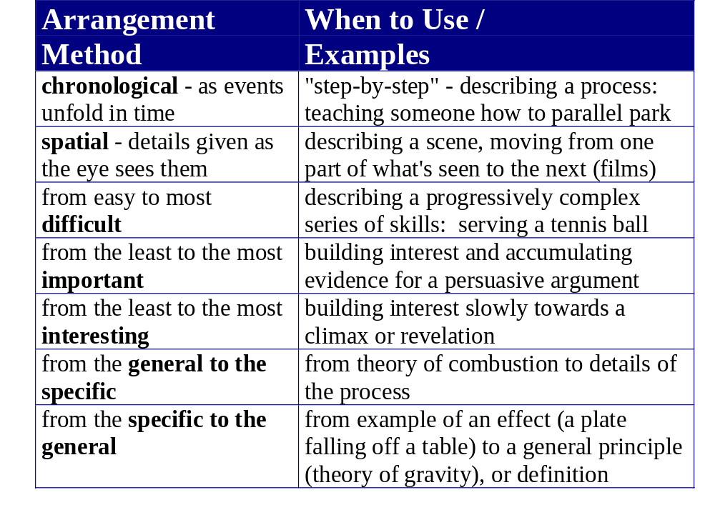
adapted from G.Levin, et. al., Prose Models (Toronto, 1997, 29).

Slide 13
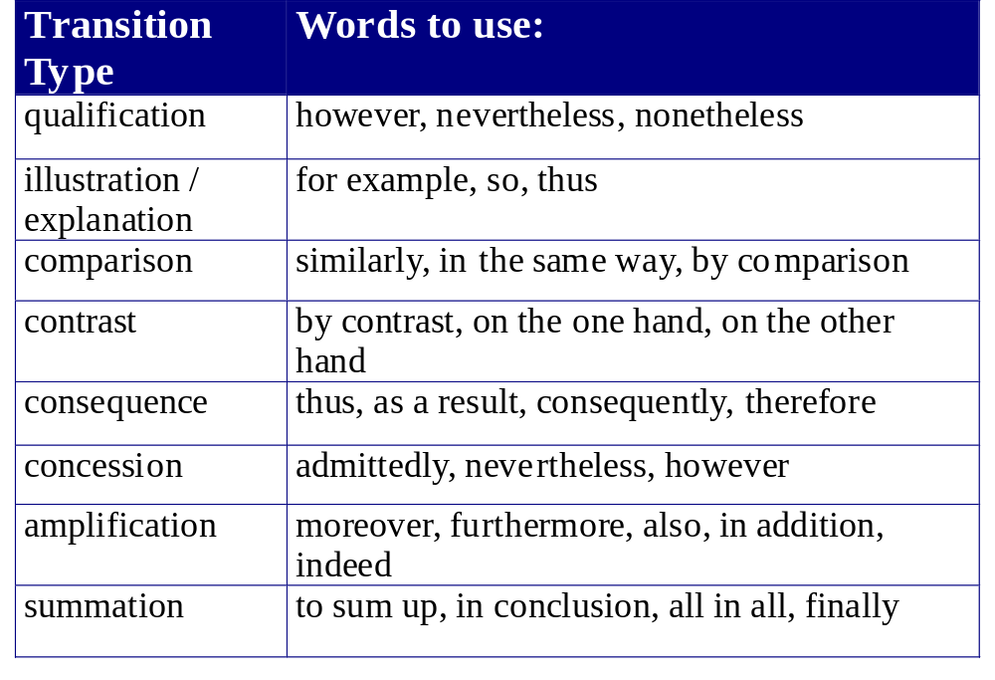
adapted G. Levin, et. al., Prose Models (Toronto, 1997, 77).

Slide 14
Beginnings, Middles, Transitions, Endings,
Every speaker, writer, and reader understands and expects a beginning, an organized middle, clear transitions, and an end.
Each have specific roles to play within a text.
In visual documents (e.g., advertising, or contemporary magazine layout) beginnings, middles, endings are sometimes hard to discern; easier for texts.

Slide 15
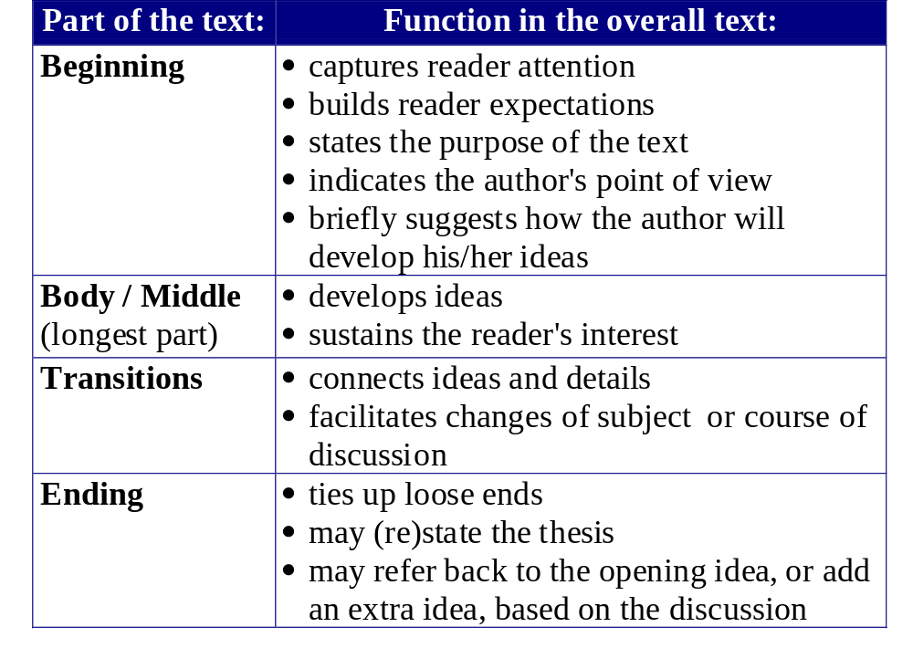
adapted from G. Levin, et. al., Prose Models (Toronto, 1997, 75-77).

Slide 16
Beginnings and Endings to Avoid
(Anthony C. Winkler & Jo Ray McKuen: Rhetoric Made Plain, 116-120)
Beginnings
"I think," "I feel," "In my opinion," "In my judgment" as an opening
  The audience assumes that the feeling, thoughts, opinions, judgments in an essay are yours
Mechanically announcing the topic: e.g., "My essay is about…" or "In this essay I am going to discuss…"
  The audience is unlikely to want to read further.

Slide 17
Beginnings and Endings, cont.
The opening that merely sums up the topic sentences of the essay.
  Avoid being dull and predictable in your essay opening
Endings
"In conclusion…", "Last but not least…", "Therefore, these are the reasons why I believe…"
  This leaves the reader feeling that the writer, "like a surly shop clerk who, having put in a minimum stay behind the counter, has decided to close up shop & go home".

Slide 18
Beginnings and Endings, cont.
Endings
An ending that repeats the opening almost word for word
  You can refer back to the beginning, but you should do so "with a twist," using different words, and adding something extra.
"I think", "I feel", "in my opinion…” as a closing
  You can use “I” in the essay, judiciously, and express your thoughts & feelings, but avoid the above phrases.

Slide 19
© BCIT
Based on LIBS 7001 Instructors’ Guide and material by Liotta, Homel, Kelly, and other members of the BCIT Liberal Studies Dept.

